Slide 1

Auto Insurance Retention
Eli Miranda

Slide 2

The Insurance Cost Conundrum
Problem
Auto Insurance carriers are always working ways to capture new costumers and struggle to retain existing customers. Inefficiencies in customer retention results in increased costs for carriers.
Solution
I will mitigate this cost by developing machine learning model(s) that will identify the likelihood of customer retention based on aspects of their demographic.
Impact
Consumer retention
Decrease need for marketing
Savings passed to customers
Achieve a significant 4% reduction in your annual premium costs for Americans!

Slide 3

DATASET & EDA
DATA QUALITY
PRELIMINARY & IN-DEPTH EDA
Data is generated.
All my data is limited to 1 state (Texas).
My marital status data is limited to single or married.
No data for customer that rent their homes.
There are multiple home market value ranges for a given city.
The distribution of customers across counties is disproportionate, which can influence model predictions.
Distribution of customers by age is relatively normal except at age 55.
Nonsense values in ‘length of residence’ columns.
Many columns have weak or no correlation.

Slide 4
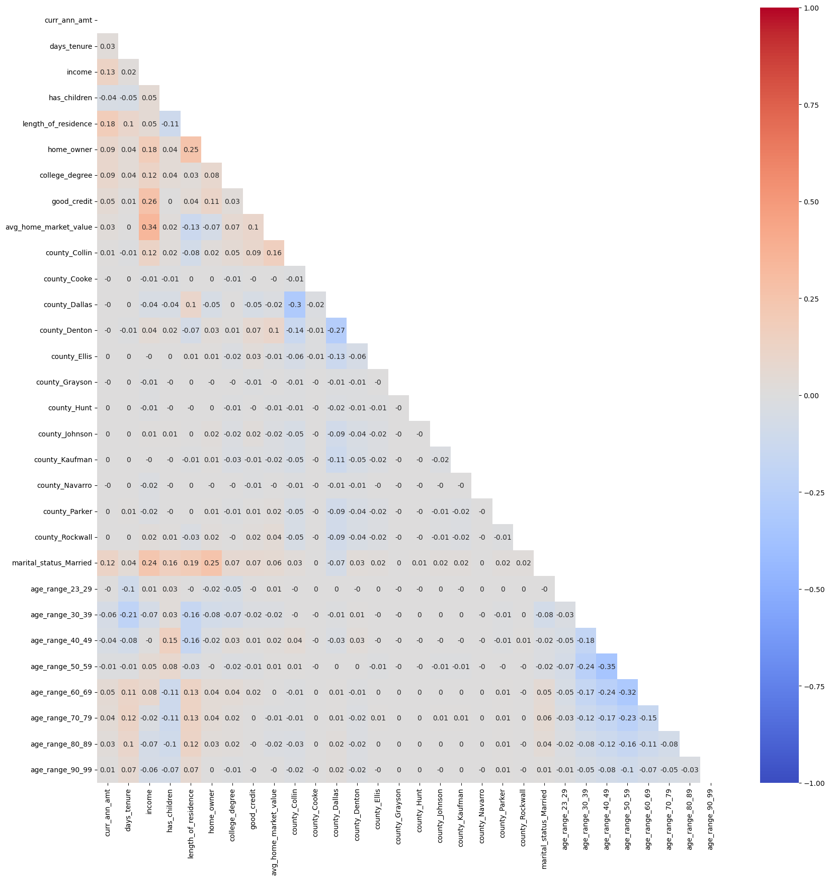
Data Processing
Heatmap of entire Dataframe
Drop columns and rows that do not have any business value and/or negatively impact the performance of models.
Ex. Columns with high multicollinearity.

Slide 5
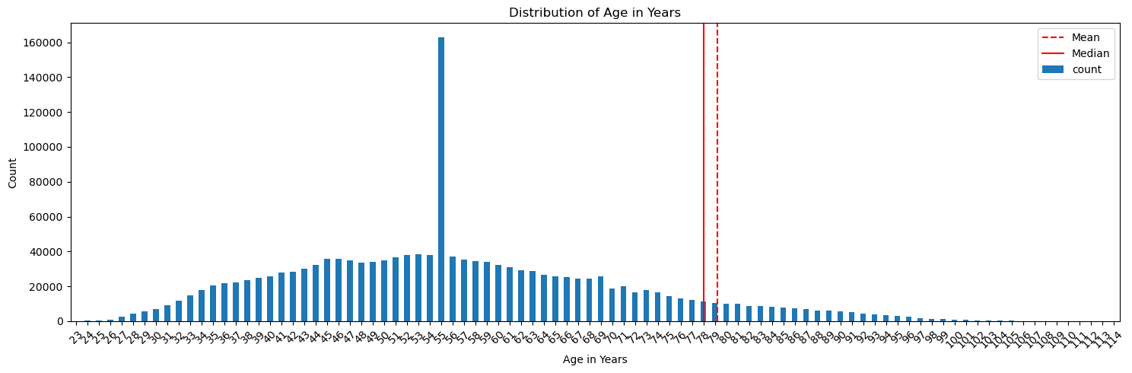
Feature Engineering
Convert categorical columns to numerical columns (Get dummies).
Consolidate large distributions.
Ex.
Age_in years
Age 55 is an outliar
Ages above 100 are pulling the mean and median right.

Slide 6

BASELINE MODELING
Logistic Models
XG Boost
Decision Trees
Train Score: 30.87%
Test Score: 30.09%
Low Accuracy
Mean Squared Error: 5111814.5000
R^2 Score: 0.0646
The model does not fit this data.
Mean cross-validation score: 11.77%
Low Accuracy

Slide 7

Next Steps
feature engineering
Additional Models
Hyperparameter tuning
Experiment more with the features
Add and drop varying combinations of features
Random Forest
Support Vector Machines
Utilize pipeline
GridSearchCV
RandomizedSearchCV

Slide 8

Thank You
Eli Miranda
Auto Insurance Retention Github
Dataset Source

Slide 9
DIVIDER

Slide 10

PRODUCT OVERVIEW
UNIQUE
TESTED
Only product specifically dedicated to investment tools for business
Conducted testing with businesses in the area
FIRST TO MARKET
AUTHENTIC
First beautifully designed product that's both stylish and functional
Designed with the help and input of investment experts in the field

Slide 11

COMPANY OVERVIEW

Slide 12

MARKET COMPARISON
$3B
$2B
$1B
Opportunity to build
Addressable market
Freedom to invent
Serviceable market
Few competitors
Obtainable market

Slide 13
GROWTH STRATEGY
How we’ll scale in the future
FEB 20XX
MAY 20XX
OCT 20XX
Roll out product to local businesses to help establish the product
Release the product to the general public and monitor stock market trends
Gather feedback from the financial community to expand availability of the product

Slide 14
OUR COMPETITION
Convenient
CONTOSO
A
Expensive
Affordable
D
C
E
B
Inconvenient

Slide 15
TWO-YEAR ACTION PLAN
Supply volunteers
Run focus groups
Gather feedback
Feb 20XX
May 20XX
Oct 20XX
20XX
JAN
FEB
MAR
APR
MAY
JUN
JUL
AUG
SEP
OCT
NOV
DEC
20XX
JAN
FEB
MAR
APR
MAY
JUN
JUL
AUG
SEP
OCT
NOV
DEC
Test with businesses
Regional launch
Deliver to consumers
Feb 20XX
July 20XX
Dec 20XX

Slide 16
FINANCIALS
 | Year 1 | Year 2 | Year 3 | Percent of Total
Income
Users | 50,000 | 400,000 | 1,600,000
Sales | 500,000 | 4,000,000 | 16,000,000
Average price per sale | 75 | 80 | 90
Revenue @ 15% | 5,625,000 | 48,000,000 | 216,000,000
Gross profit | 5,625,000 | 48,000,000 | 216,000,000
Expenses
Sales & marketing | 5,062,500 | 38,400,000 | 151,200,000 | 70%
Customer service | 1,687,500 | 9,600,000 | 21,600,000 | 10%
Product development | 562,500 | 2,400,000 | 10,800,000 | 5%
Research | 281,250 | 2,400,000 | 4,320,000 | 2%
Total expenses | 7,593,750 | 52,800,000 | 187,920,000

Slide 17
FUNDING
MUTUAL FUNDS
ANGEL INVESTMENTS
CASH
SHARES
$12,000
$14,000
$32,000
$82,000
Revenue obtained from blue chip mutual funds
Amount obtained through other investors
Liquid cash we have on hand
Number of shares converted into USD

Slide 18

SUMMARY
At Contoso, we believe in giving 110%. By closing the loop on investment management and using the latest technology, we help businesses grow and expand their portfolio funds. We thrive because of our market knowledge and a great team behind our product. As our CEO says, "Efficiencies will come from proactively transforming how we do business."
summary

